Slide 1
CHEMICAL REACTIONS
SAVE PAPER AND INK!!! When you print out the notes on PowerPoint, print "Handouts" instead of "Slides" in the print setup. Also, turn off the backgrounds (Tools>Options>Print>UNcheck "Background Printing")!
Chemistry I – Chapter 11a
Chemistry I Honors – Chapter 7
ICP – Chapter 21a
Reactants: Zn + I₂
Product: Zn I₂

Slide 2
Chemical Equations
Their Job: Depict the kind of reactants and products and their relative amounts in a reaction.
4 Al _{(s)} + 3 O_{2 (g)} ---> 2 Al₂O_{3 (s)}
The numbers in the front are called
stoichiometric ____________
The letters (s), (g), and (l) are the physical states of compounds.

Slide 3
Introduction
  Chemical reactions occur when bonds between the outermost parts of atoms are formed or broken
  Chemical reactions involve changes in matter, the making of new materials with new properties, and energy changes.
  Symbols represent elements, formulas describe compounds, chemical equations describe a chemical reaction

Slide 4
Parts of a Reaction Equation
  Chemical equations show the conversion of reactants (the molecules shown on the left of the arrow) into products (the molecules shown on the right of the arrow).
    A + sign separates molecules on the same side
    The arrow is read as “yields”
    Example
      C + O₂ → CO₂
    This reads “carbon plus oxygen react to yield carbon dioxide”

Slide 5
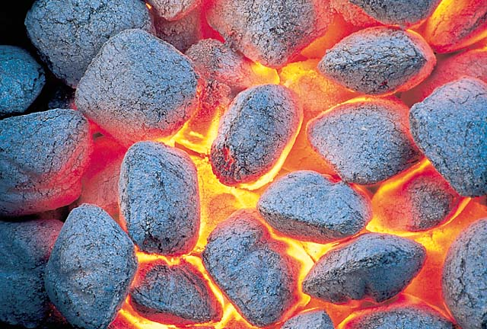
The charcoal used in a grill is basically carbon. The carbon reacts with oxygen to yield carbon dioxide. The chemical equation for this reaction, C + O₂ → CO₂, contains the same information as the English sentence but has quantitative meaning as well.

Slide 6
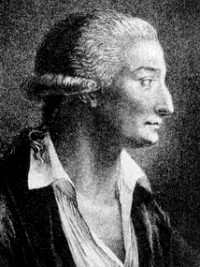
Chemical Equations
Because of the principle of the conservation of matter,
an equation must be balanced.
It must have the same number of atoms of the same kind on both sides.
Lavoisier, 1788

Slide 7
Symbols Used in Equations
    Solid ___
    Liquid (l)
    Gas ___
    Aqueous solution (aq)
    Catalyst ^{H2SO4}
    Escaping gas (↑)
    Change of temperature (Δ)

Slide 8
Balancing Equations
  When balancing a chemical reaction you may add coefficients in front of the compounds to balance the reaction, but you may not change the subscripts.
    Changing the subscripts changes the compound. Subscripts are determined by the valence electrons (charges for ionic or sharing for covalent)

Slide 9
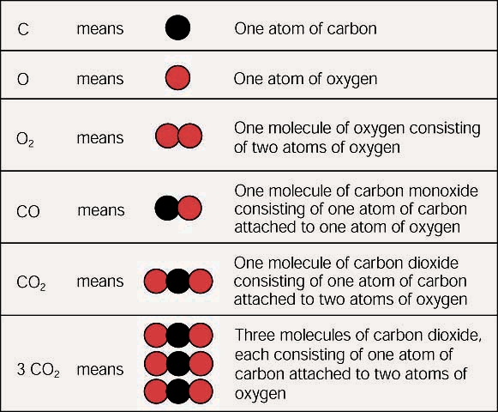
Subscripts vs. Coefficients
The subscripts tell you how many atoms of a particular element are in a compound. The coefficient tells you about the quantity, or number, of molecules of the compound.

Slide 10
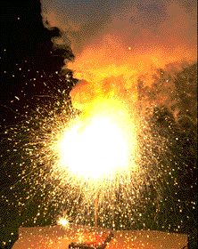
Chemical Equations
4 Al(s) + 3 O₂(g) ---> 2 Al₂O₃(s)
This equation means
4 Al atoms + 3 O₂ molecules ---produces--->
2 molecules of Al₂O₃
_{AND/OR}
4 moles of Al + 3 moles of O₂ ---produces--->
2 moles of Al₂O₃

Slide 11
Steps to Balancing Equations
  There are four basic steps to balancing a chemical equation.
    Write the correct formula for the reactants and the products. DO NOT TRY TO BALANCE IT YET! You must write the correct formulas first. And most importantly, once you write them correctly DO NOT CHANGE THE FORMULAS!
    Find the number of atoms for each element on the left side. Compare those against the number of the atoms of the same element on the right side.
    Determine where to place coefficients in front of formulas so that the left side has the same number of atoms as the right side for EACH element in order to balance the equation.
    Check your answer to see if:
      The numbers of atoms on both sides of the equation are now balanced.
      The coefficients are in the lowest possible whole number ratios. (reduced)

Slide 12
Some Suggestions to Help You
  Some of Mr. Rapp’s Helpful Hints for balancing equations:
    Take one element at a time, working left to right except for H and O. Save H for next to last, and O until last.
    IF everything balances except for O, and there is no way to balance O with a whole number, double all the coefficients and try again. (Because O is diatomic as an element)
    (Shortcut) Polyatomic ions that appear on both sides of the equation should be balanced as independent units

Slide 13
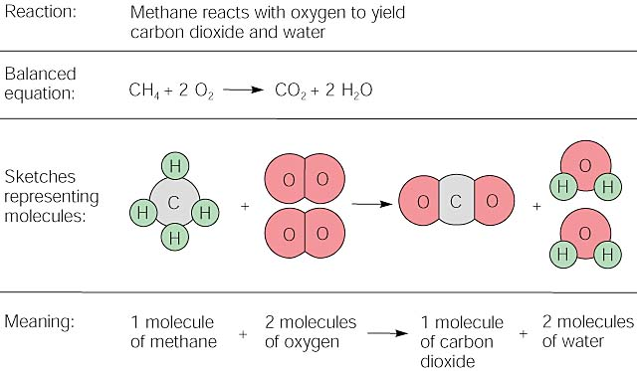

Slide 14
Balancing Equations
2
2
___ H₂(g) + ___ O₂(g) ---> ___ H₂O(l)
What Happened to the Other Oxygen Atom?????
This equation is not balanced!
Two hydrogen atoms from a hydrogen molecule (H₂) combines with one of the oxygen atoms from an oxygen molecule (O₂) to form H₂O. Then, the remaining oxygen atom combines with two more hydrogen atoms (from another H₂ molecule) to make a second H₂O molecule.

Slide 15
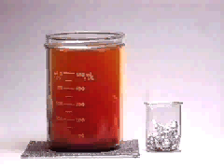
Balancing
Equations
2
3
___ Al(s) + ___ Br₂(l) ---> ___ Al₂Br₆(s)

Slide 16
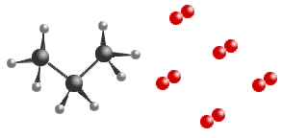
Balancing Equations
____C₃H₈(g) + _____ O₂(g) ----> _____CO₂(g) + _____ H₂O(g)
____B₄H₁₀(g) + _____ O₂(g) ----> ___ B₂O₃(g) + _____ H₂O(g)

Slide 17
Balancing Equations
Sodium phosphate + iron (III) oxide → sodium oxide + iron (III) phosphate
Na₃PO₄ + Fe₂O₃ ----> Na₂O + FePO₄

