Slide 1
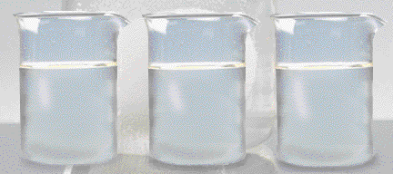
Solutions
Chemistry I – Chapters 15 & 16
Chemistry I HD – Chapter 15
ICP – Chapter 22
SAVE PAPER AND INK!!! When you print out the notes on PowerPoint, print "Handouts" instead of "Slides" in the print setup. Also, turn off the backgrounds (Tools>Options>Print>UNcheck "Background Printing")!
Why does a raw egg swell or shrink when placed in different solutions?
Notes:
To play the movies and simulations included, view the presentation in Slide Show Mode.

Slide 2
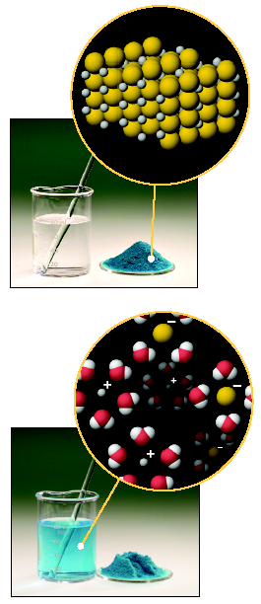
Some Definitions
A solution is a _______________ mixture of 2 or more substances in a single phase.
One constituent is usually regarded as the SOLVENT and the others as SOLUTES.

Slide 3
Parts of a Solution
SOLUTE – the part of a solution that is being dissolved (usually the lesser amount)
SOLVENT – the part of a solution that dissolves the solute (usually the greater amount)
Solute + Solvent = Solution
Solute | Solvent | Example
solid | solid
solid | liquid
gas | solid
liquid | liquid
gas | liquid
gas | gas

Slide 4
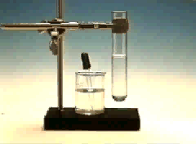
Definitions
Solutions can be classified as saturated or unsaturated.
A saturated solution contains the maximum quantity of solute that dissolves at that temperature.
An unsaturated solution contains less than the maximum amount of solute that can dissolve at a particular temperature

Slide 5
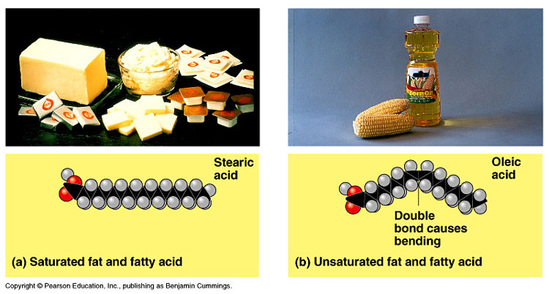
Example: Saturated and Unsaturated Fats
Saturated fats are called saturated because all of the bonds between the carbon atoms in a fat are single bonds. Thus, all the bonds on the carbon are occupied or “saturated” with hydrogen. These are stable and hard to decompose. The body can only use these for energy, and so the excess is stored. Thus, these should be avoided in diets. These are usually obtained from sheep and cattle fats. Butter and coconut oil are mostly saturated fats.
Unsaturated fats have at least one double bond between carbon atoms; monounsaturated means there is one double bond, polysaturated means there are more than one double bond. Thus, there are some bonds that can be broken, chemically changed, and used for a variety of purposes. These are REQUIRED to carry out many functions in the body. Fish oils (fats) are usually unsaturated. Game animals (chicken, deer) are usually less saturated, but not as much as fish. Olive and canola oil are monounsaturated.

Slide 6
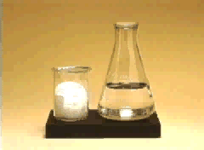
Definitions
SUPERSATURATED SOLUTIONS contain more solute than is possible to be dissolved
Supersaturated solutions are unstable. The supersaturation is only temporary, and usually accomplished in one of two ways:
Warm the solvent so that it will dissolve more, then cool the solution
Evaporate some of the solvent carefully so that the solute does not solidify and come out of solution.

Slide 7
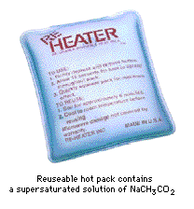
Supersaturated Sodium Acetate
One application of a supersaturated solution is the sodium acetate “heat pack.”

Slide 8
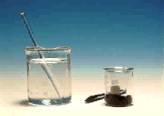
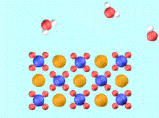
IONIC COMPOUNDS
Compounds in Aqueous Solution
Many reactions involve ionic compounds, especially reactions in water — aqueous solutions.
KMnO₄ in water
K⁺(aq) + MnO₄⁻(aq)
Notes:
To play the movies and simulations included, view the presentation in Slide Show Mode.

Slide 9
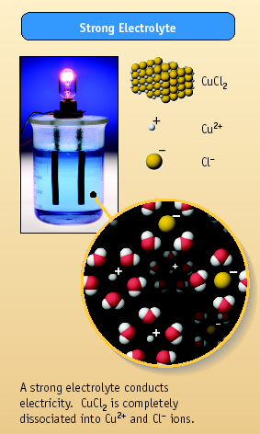
Aqueous Solutions
How do we know ions are present in aqueous solutions?
The solutions _________________________
They are called ELECTROLYTES
HCl, MgCl₂, and NaCl are strong electrolytes. They dissociate completely (or nearly so) into ions.

Slide 10
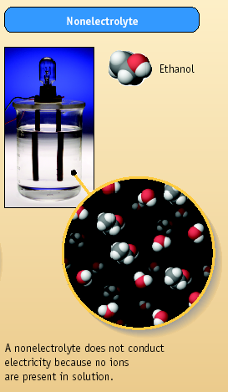
Aqueous Solutions
Some compounds dissolve in water but do not conduct electricity. They are called nonelectrolytes.
Examples include:
sugar
ethanol
ethylene glycol

Slide 11
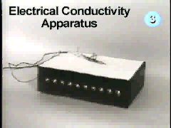
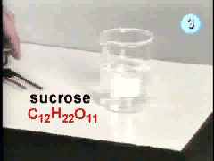
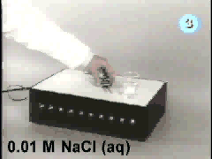
It’s Time to Play Everyone’s Favorite Game Show… Electrolyte or Nonelectrolyte!

Slide 12
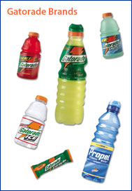
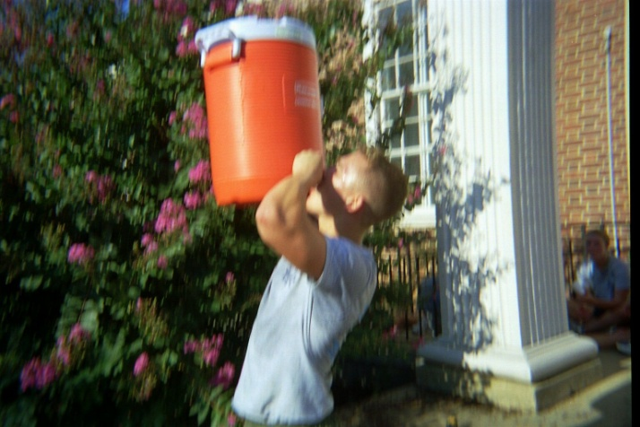
Electrolytes in the Body
Carry messages to and from the brain as electrical signals
Maintain cellular function with the correct concentrations electrolytes
Make your own
50-70 g sugar One liter of warm water Pinch of salt 200ml of sugar free fruit squash Mix, cool and drink

Slide 13
Concentration of Solute
The amount of solute in a solution is given by its concentration.
=
moles solute
Molarity
(
M
)
liters of solution

Slide 14
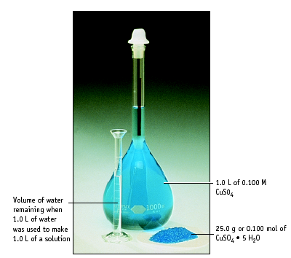
1.0 L of water was used to make 1.0 L of solution. Notice the water left over.

Slide 15
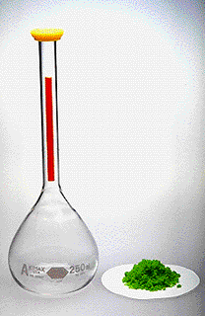
PROBLEM: Dissolve 5.00 g of NiCl₂ in enough water to make 250 mL of solution. Calculate the Molarity.
Step 1: Calculate moles of NiCl₂
Step 2: Calculate Molarity
[NiCl₂] = 0.154 M

Slide 16
USING MOLARITY
What mass of oxalic acid, H₂C₂O₄, is
required to make 250. mL of a 0.0500 M
solution?
moles = M•V
Step 1: Change mL to L.
250 mL * 1L/1000mL = 0.250 L
Step 2: Calculate.
Moles = (0.0500 mol/L) (0.250 L) = 0.0125 moles
Step 3: Convert moles to grams.
(0.0125 mol)(90.00 g/mol) = 1.13 g

Slide 17
Learning Check
How many grams of NaOH are required to prepare 400. mL of 3.0 M NaOH solution?
1) 12 g
2) 48 g
3) 300 g

Slide 18
Concentration Units
An IDEAL SOLUTION is one where the properties depend only on the concentration of solute.
Need conc. units to tell us the number of solute particles per solvent particle.
The unit “molarity” does not do this!

Slide 19
Two Other Concentration Units
MOLALITY, m
mol solute
m of solution
=
kilograms solvent
% by mass
grams solute
grams solution
% by mass =

Slide 20
Calculating Concentrations
Dissolve 62.1 g (1.00 mol) of ethylene glycol in 250. g of H₂O. Calculate molality and % by mass of ethylene glycol.

Slide 21
Calculating Concentrations
Dissolve 62.1 g (1.00 mol) of ethylene glycol in 250. g of H₂O. Calculate m & % of ethylene glycol (by mass).
Calculate molality
Calculate weight %

Slide 22

Learning Check
A solution contains 15 g Na₂CO₃ and 235 g of H₂O. What is the mass % of the solution?
1) 15% Na₂CO₃
2) 6.4% Na₂CO₃
3) 6.0% Na₂CO₃

Slide 23
Using mass %
How many grams of NaCl are needed to prepare 250 g of a 10.0% (by mass) NaCl solution?

Slide 24
Try this molality problem
25.0 g of NaCl is dissolved in 5000. mL of water. Find the molality (m) of the resulting solution.
m = mol solute / kg solvent
25 g NaCl 1 mol NaCl
58.5 g NaCl
= 0.427 mol NaCl
Since the density of water is 1 g/mL, 5000 mL = 5000 g, which is 5 kg
0.427 mol NaCl
5 kg water
= 0.0854 m salt water

Slide 25
Colligative Properties
On adding a solute to a solvent, the properties of the solvent are modified.
Vapor pressure decreases
Melting point decreases
Boiling point increases
Osmosis is possible (osmotic pressure)
These changes are called COLLIGATIVE PROPERTIES.
They depend only on the NUMBER of solute particles relative to solvent particles, not on the KIND of solute particles.

Slide 26
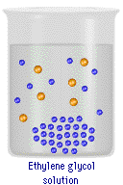
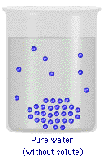
Change in Freezing Point
Ethylene glycol/water
solution
Pure water
The freezing point of a solution is LOWER than that of the pure solvent

Slide 27
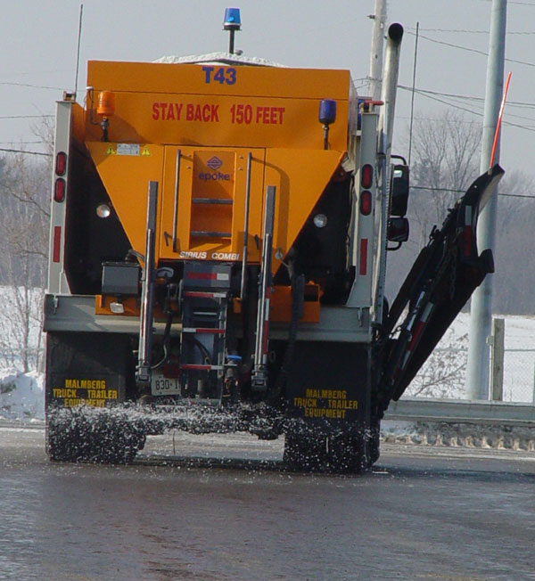
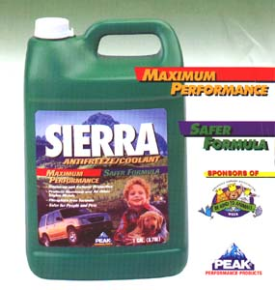
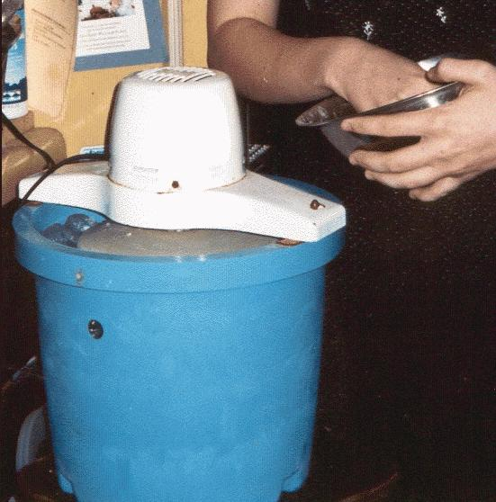
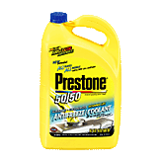
Change in Freezing Point
Common Applications of Freezing Point Depression
Ethylene glycol – deadly to small animals
Propylene glycol

Slide 28
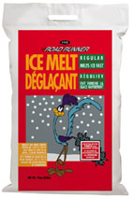
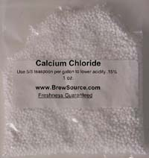

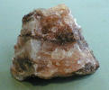
Change in Freezing Point
Common Applications of Freezing Point Depression
Which would you use for the streets of Bloomington to lower the freezing point of ice and why? Would the temperature make any difference in your decision?
sand, SiO₂
Rock salt, NaCl
Ice Melt, CaCl₂

Slide 29
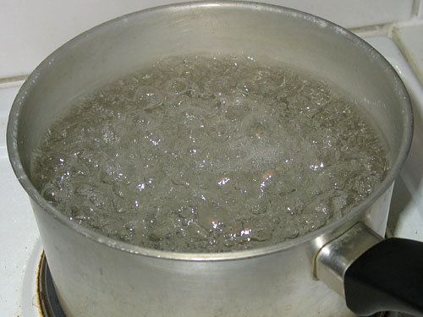
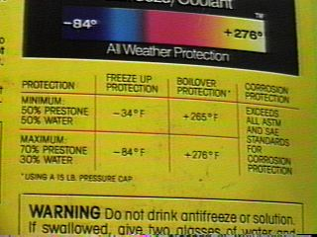
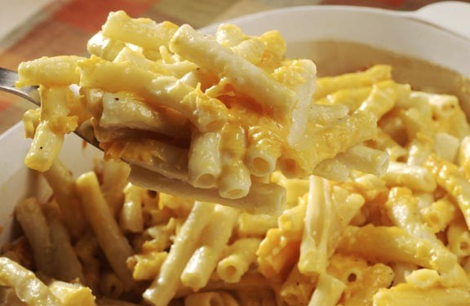
Change in Boiling Point
Common Applications of Boiling Point Elevation

Slide 30
Boiling Point Elevation and Freezing Point Depression
∆T = K•m•i
i = van’t Hoff factor = number of particles produced per molecule/formula unit. For covalent compounds, i = 1. For ionic compounds, i = the number of ions present (both + and -)
Compound Theoretical Value of i
glycol 1
NaCl 2
CaCl₂ 3
Ca₃(PO₄)₂ 5

Slide 31
Boiling Point Elevation and Freezing Point Depression
∆T = K•m•i
m = molality
K = molal freezing
point/boiling point constant
Substance | K_{f}
benzene | 5.12
camphor | 40.
carbon tetrachloride | 30.
ethyl ether | 1.79
water | 1.86
Substance | K_{b}
benzene | 2.53
camphor | 5.95
carbon tetrachloride | 5.03
ethyl ether | 2.02
water | 0.52

Slide 32
Change in Boiling Point
Dissolve 62.1 g of glycol (1.00 mol) in 250. g of water. What is the boiling point of the solution?
K_{b} = 0.52 ºC/molal for water (see K_{b} table).
Solution ∆T_{BP} = K_{b} • m • i
1. Calculate solution molality = 4.00 m
2. ∆T_{BP} = K_{b} • m • i
∆T_{BP} = 0.52 ºC/molal (4.00 molal) (1)
∆T_{BP} = 2.08 ºC
BP = 100 + 2.08 = 102.08 ºC
(water normally boils at 100)

Slide 33
Freezing Point Depression
Calculate the Freezing Point of a 4.00 molal glycol/water solution.
K_{f} = 1.86 ºC/molal (See K_{f} table)
Solution
∆T_{FP} = K_{f} • m • i
= (1.86 ºC/molal)(4.00 m)(1)
∆T_{FP} = 7.44
FP = 0 – 7.44 = -7.44 ºC
(because water normally freezes at 0)

Slide 34
Freezing Point Depression
At what temperature will a 5.4 molal solution of NaCl freeze?
Solution
∆T_{FP} = K_{f} • m • i
∆T_{FP} = (1.86 ºC/molal) • 5.4 m • 2
∆T_{FP} = 20.1 ºC
FP = 0 – 20.1 = -20.1 ºC

Slide 35
Preparing Solutions
Weigh out a solid solute and dissolve in a given quantity of solvent.
Dilute a concentrated solution to give one that is less concentrated.

Slide 36
ACID-BASE REACTIONS
Titrations
H₂C₂O₄(aq) + 2 NaOH(aq) --->
acid base
Na₂C₂O₄(aq) + 2 H₂O(liq)
Carry out this reaction using a TITRATION.
Oxalic acid,
H₂C₂O₄

Slide 37
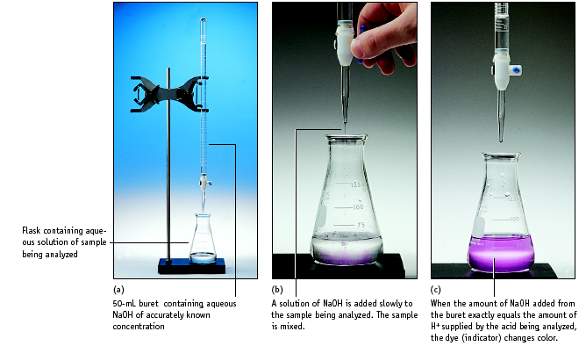
Setup for titrating an acid with a base

Slide 38
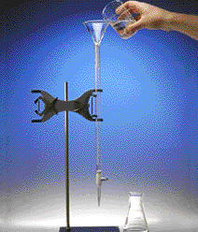
Titration
1. Add solution from the buret.
2. Reagent (base) reacts with compound (acid) in solution in the flask.
Indicator shows when exact stoichiometric reaction has occurred. (Acid = Base)
This is called NEUTRALIZATION.

